Slide 1
OUR P1 and 2 memories
Made by the two Hannah's in P4

Slide 2
P1 class
In P1 we came into the class room for the first time and we were nervous. We sat down and you came over and said don’t be nervous I will help you with all the things what we are going to do in P1 and2. After Mrs Beattie said that we were not as nervous but we were still a bit nervous. The second day Miss McKibben took us out to the cloakroom we learned abcd. We went back into the class and we coloured in the pictures and wrote the letters we enjoyed our 2 days at school so far.

Slide 3
The rest of P1
We enjoyed P1 we were very excited

Slide 4
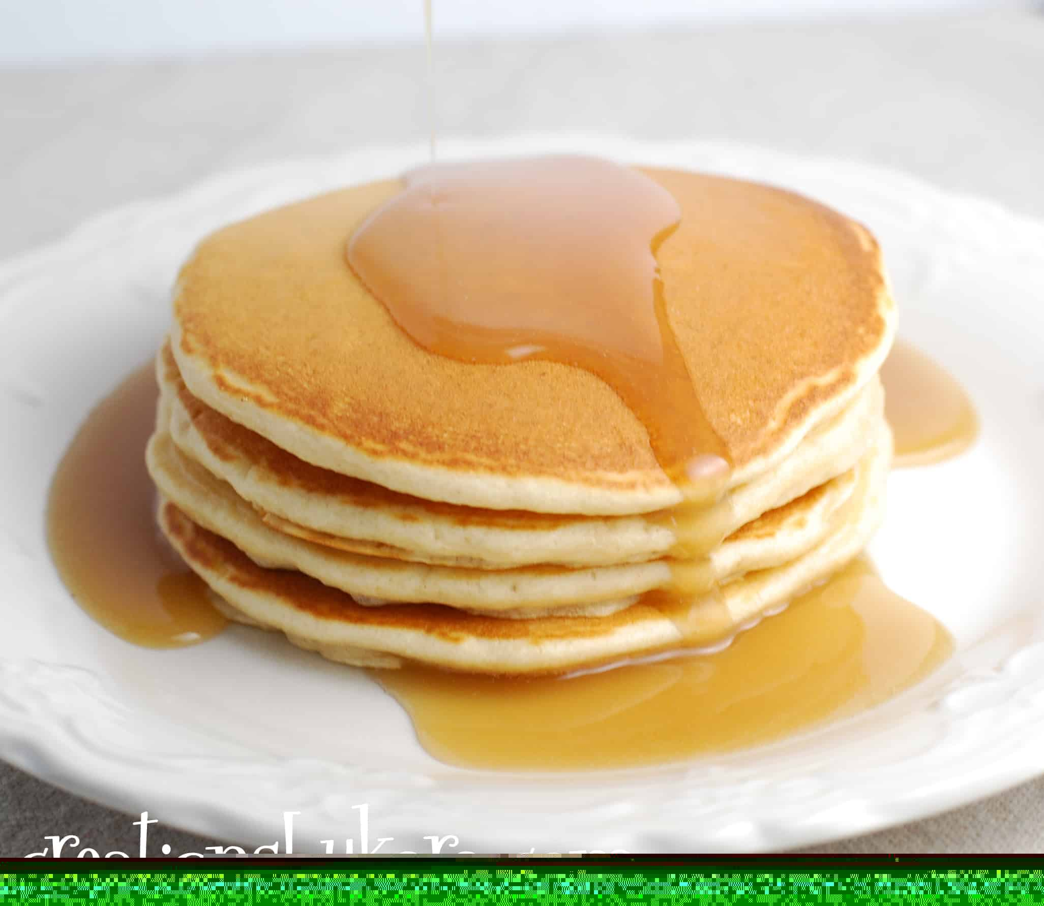
Hannahc liked your delicious pancakes

Slide 5
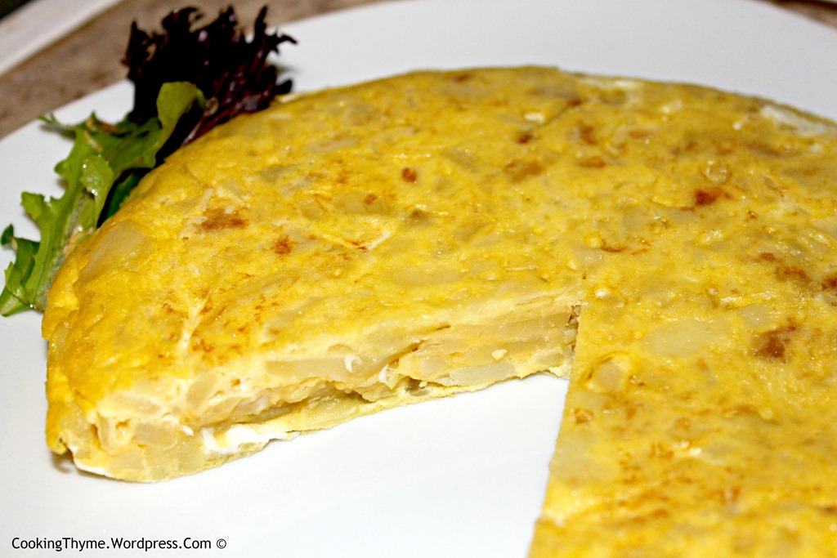
Hannaht liked your tortilla

Slide 6
Our feelings
Happy
Bright
Sad/because you are leaving.
Thankful/because you are the best teacher
We are smart now because you taught us to be smart and that’s how we learned to be smart

Slide 7
I like your sandwiches and biscuits in busy bees.

Slide 8
You are very kind times 10000 to pupils and staff

Slide 9
You’re the best

